Slide 1


So we are going to learn what is AWS, How it works some history , services , and the competitors of AWS so lets start with basic information ………
Going to learn

Slide 2
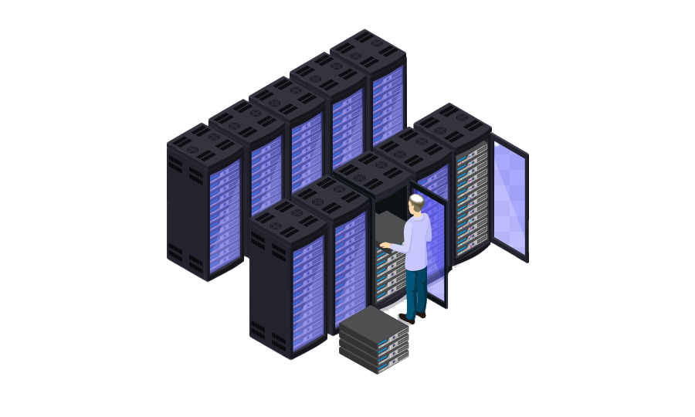
What is a Server?
Which serve services to the user …ex in pratical world is paytm app etc….

Slide 3
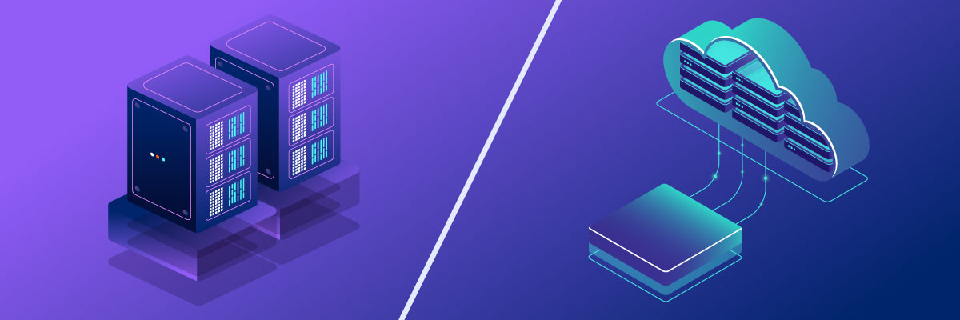
Physical Server Cloud server

Slide 4
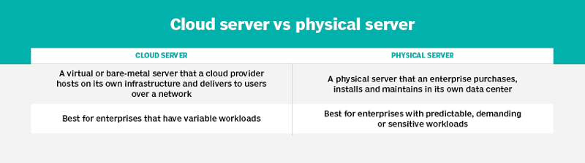
Physical Server Cloud server

Slide 5

In traditional Businesses and companies had to buy, maintain, and upgrade expensive physical servers.
Traditional It
High costs - for expensive hardware, maintenance and IT teams.
Time-comsuming – setting up and updating servers takes weeks or months!

Slide 6
How to build a server ?

Slide 7

How to build a server ?
AWS

Slide 8


Slide 9
To create a server we required components like Operating system, Hardware CPU RAM, Security, Network, Storage So we will just pay some x amount and Cloud provider will provide us all of them.
What is EC2?
• EC2 stands for Elastic Compute Cloud
• It's a virtual server in the cloud
• You can run applications and store data
• Pay only for what you use
• Helps you scale up or down easily
Key Features of EC2
• Multiple instance types (like small, medium, large)
• Different OS choices (Linux, Windows)
• Secure with key pair and security groups
• Attach storage (EBS) to instances
• Auto-scaling and load balancing support
EC2 Instance Lifecycle
• Pending: Instance is launching
• Running: Instance is active
• Stopping: Instance is shutting down
• Stopped: Instance is off (not billed)
• Terminated: Instance is deleted

Slide 10
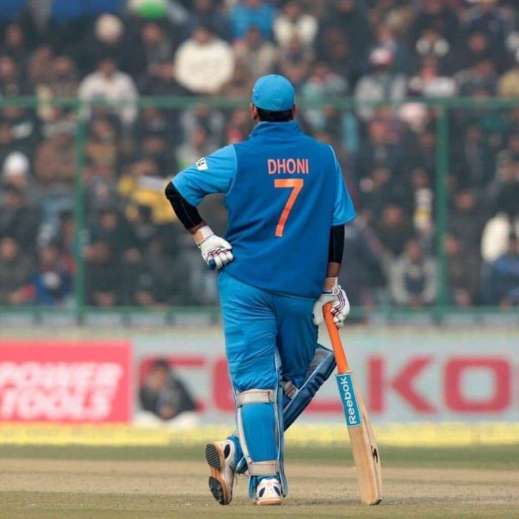
Steps to Create EC2

Slide 11

STEP -1: Name & Tags
TAGS: To Identify servers
NAME: web-server
CLIENT: abccc
ENV: Production

Slide 12

STEP -2: AMAZON MACHINE IMAGE
OPERATING SYSTEM SOFTWARES ETC…..

Slide 13

STEP -3: INSTANCE TYPE
CPU & RAM
DEFAULT: T2.MICRO
1-CPU & 1-GB RAM
MAX: U-24TB.METAL
448-CPUS & 24,576-GB RAM

Slide 14

STEP -4: KEY-PAIR
FOR SAFE AND SECURE LOGIN TO SERVER
1.PUBLIC KEY: STORE BY AWS
2.PRIVATE KEY: STORE BY USER
PRIVATE KEY: (PEM & PPK)

Slide 15

STEP -5: NETWORK & SECURITY
VPC: VIRTUAL PRIVATE CLOUD
USED TO ISOLATE SERVERS
RESPONSIBLE FOR NETWORK
CREATES OUR OWN NETWORK

Slide 16

STEP -5: FIREWALL
SECURITY GROUPS
USED TO ALLOW/DENY TRAFFIC TO SERVERS
REQUEST = IN-COMING
RESPONSE = OUT-GOING
IMPORTANT RULES:
SSH: SECURE SHELL:22 RESPONSIBLE TO COMMUNICATE WITH OTHER SERVERS
HTTP : 80
HTTPS :443

Slide 17
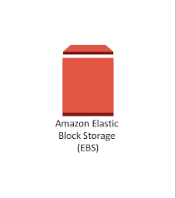
STEP -6: STORAGE
EBS: ELASTIC BLOCK STORAGE
TO PROVIDES STORAGE FOR THE SERVER
DEFAULT: 8GB
MAX:16TB

Slide 18
STEP -7: ADVANCE DETAILS
SCRIPTS
PERMISSION
SERVER BEHAVIOUR
SERVER PLACEMENT………..

Slide 19
STORAGE

Slide 20

MIN:15GB (FREE) MAX:30 TB (NOT FREE)

Slide 21

WHAT IF I WANT TO STORE PETA BYTES OF DATA

Slide 22
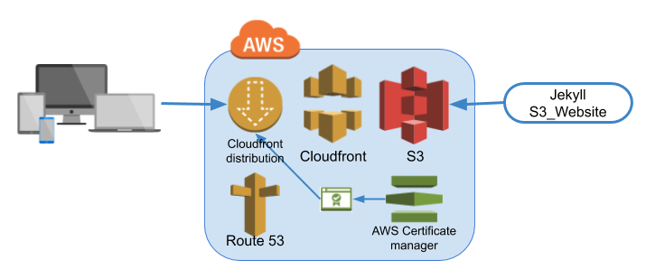
AWS S3

Slide 23
WHAT IS S3…?
Amazon S3 is a simple storage service.
Store objects like files photos audios videos.
Providing more scalability security.
It allows user to store and retrieve .
Many companies use S3 to store customer data.
It has infinite scaling capacity.

Slide 24
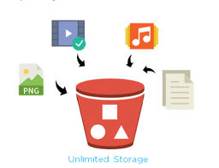

VIDEOS
AUDIOS
IMAGES
FILES
HIGHLY SECURE
THIS SERVICE NAME IS S3 (SIMPLE STORAGE SERVICE) . IT IS A INFINITE STORAGE.

Slide 25

BBS PRESERVES 100 YEARS OF HISTORY USING AMAZON S3

Slide 26

BY USING S3 THE BANK IS SAVING $380,500/YEARS INR: 3,19,48,682

Slide 27
S3 Key Concepts
• Buckets: Containers for storing objects
• Objects: Files (data + metadata)
• Keys: Unique name for each object in a bucket
• Region: Physical location of your data
• Storage Classes: Different cost & access levels

Slide 28
Steps to Create an S3 Bucket
1. Login to AWS Console
2. Go to S3 service
3. Click 'Create Bucket'
4. Enter Bucket Name and choose Region
5. Set options (versioning, encryption, etc.)
6. Set permissions (access control)
7. Click 'Create'

Slide 29
S3 Storage Classes
• S3 Standard – Frequent access
• S3 Intelligent-Tiering – Auto cost saving
• S3 Standard-IA – Infrequent access
• S3 One Zone-IA – Infrequent, single zone
• S3 Glacier – Archive with retrieval time
• S3 Glacier Deep Archive – Long-term storage

Slide 30
S3 Permissions & Security
• IAM Policies: Who can access what
• Bucket Policies: Control access at bucket level
• ACLs: Legacy access control
• Encryption: Server-side (SSE) and client-side
• Versioning and MFA Delete for protection

Slide 31
Advantages…..
To store all types of Data
Static web hosting
Big Data Analytics
Backup and Recovery
Highly scalable & Flexible
Low Cost

Slide 32
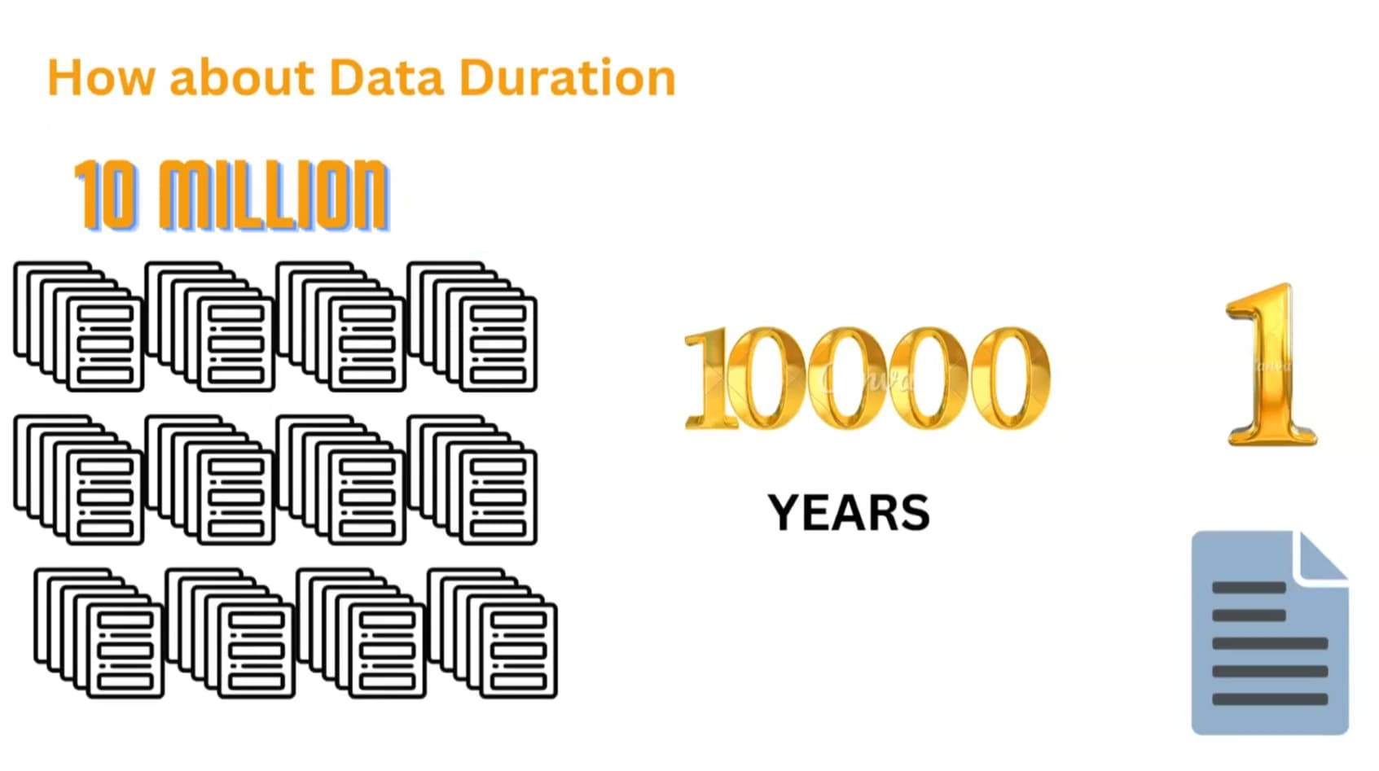

Slide 33
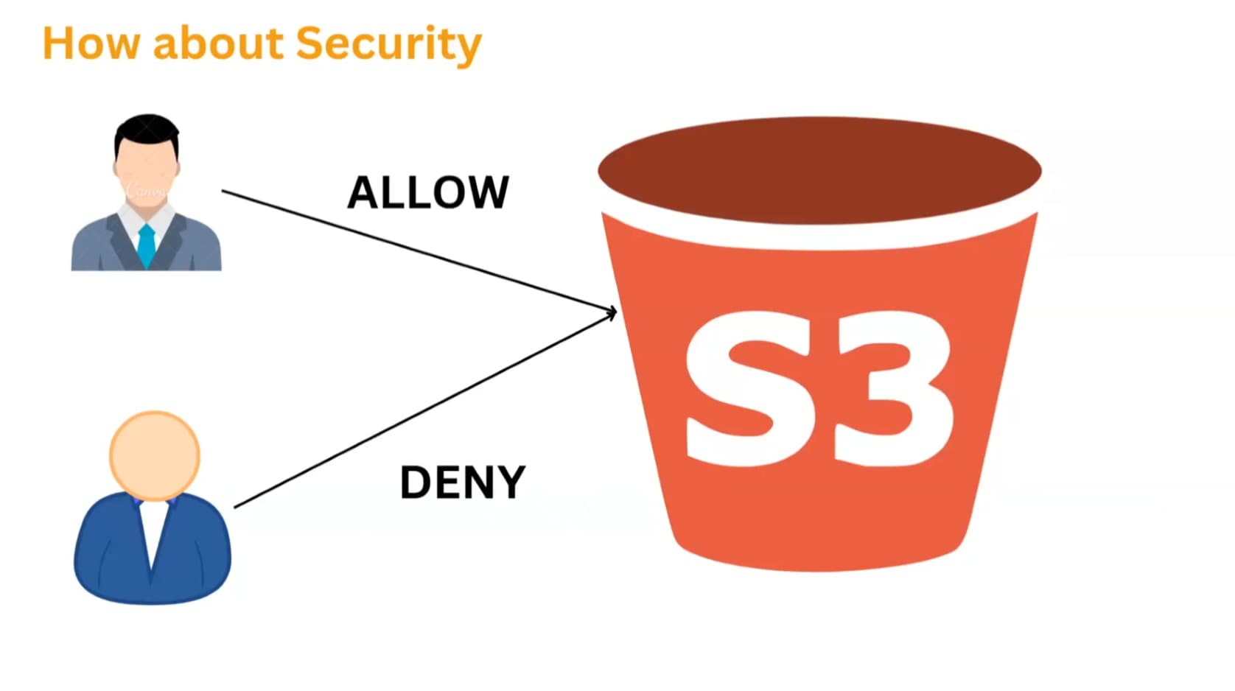

Slide 34
RULES…..
3 (min) 63 (max) characters long.
Can consist only of lowercase letters, numbers, dots(.), and hyphens(-).
Must being and end with letter or number.
Bucket names must not contain two adjacent periods.
Bucket names must not be formatted as an IP address (for example, 192.37.5.2).

Slide 35
Ways to upload diles…..
GUI
CLI

Slide 36
How much is free…..
The maximum size of an AWS S3 bucket is 5TB is free.

Slide 37

WHAT IF USER DELETE A FILE BYY CHANCE

Slide 38

ORIGINAL FILE
COPY FILE
SAME SAME BUT DIFFERENT

Slide 39
Versioning…?
Versioning means Copy of Object.
If you delete a file we can retrieve using Versioning.
By default it will be disabled.
Each file will have Different Version Id.
You can always restore the previous version.

Slide 40
THANK YOU..!

